Slide 1

Data science project
DONE BY : - Huang Longqian - mao yinan - Mansoor

Slide 2
content
Part (1) Probability terms dataset analysis 1- Box Plot
2- Heat Map
3- Radar Map
4- Rose Chart

Slide 3
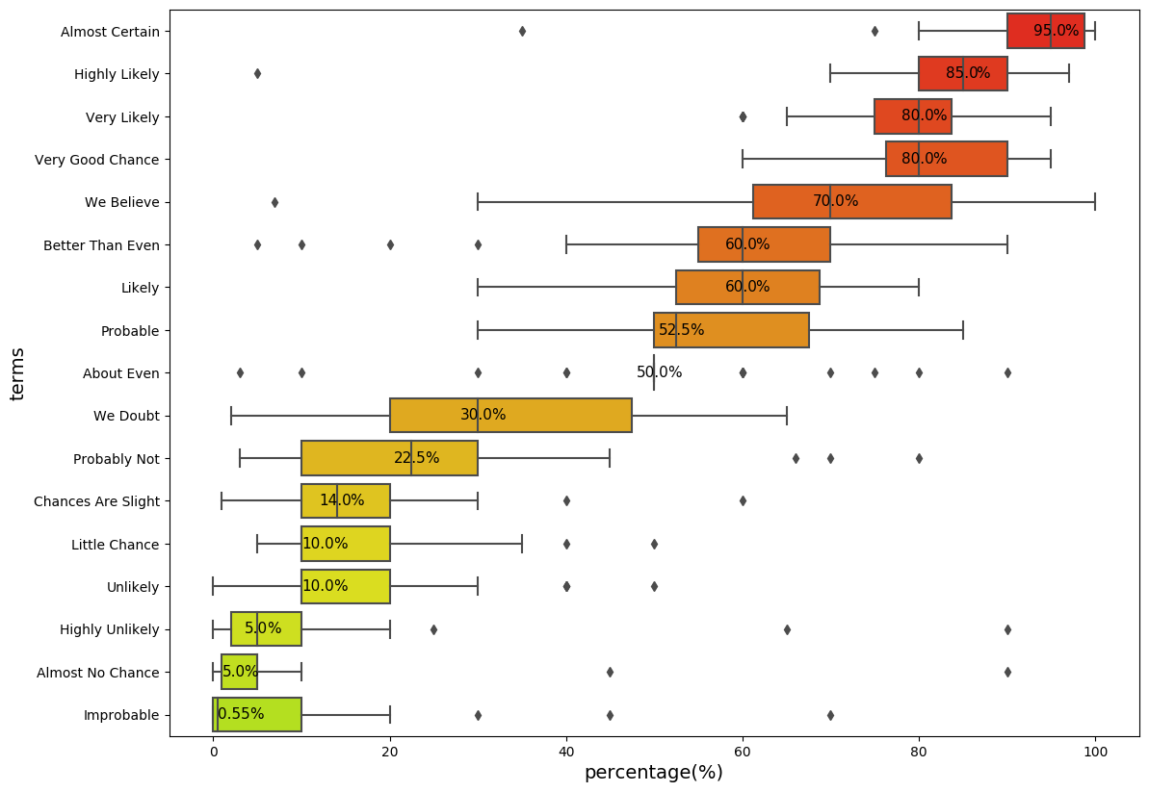
Using Box plot
Use seabron library
More red, more probability
More dark with green, less probability
Interesting fingdings:

Slide 4
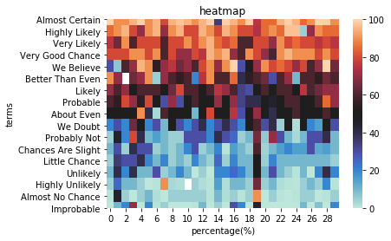
Using heat map
Look at me!!!!
file:///Users/huanglongqian/Desktop/Rader.html

Slide 6
Using radar map

Slide 8
Using rose chart

Slide 11
PART 2

Slide 16

Thank You

